Slide 1
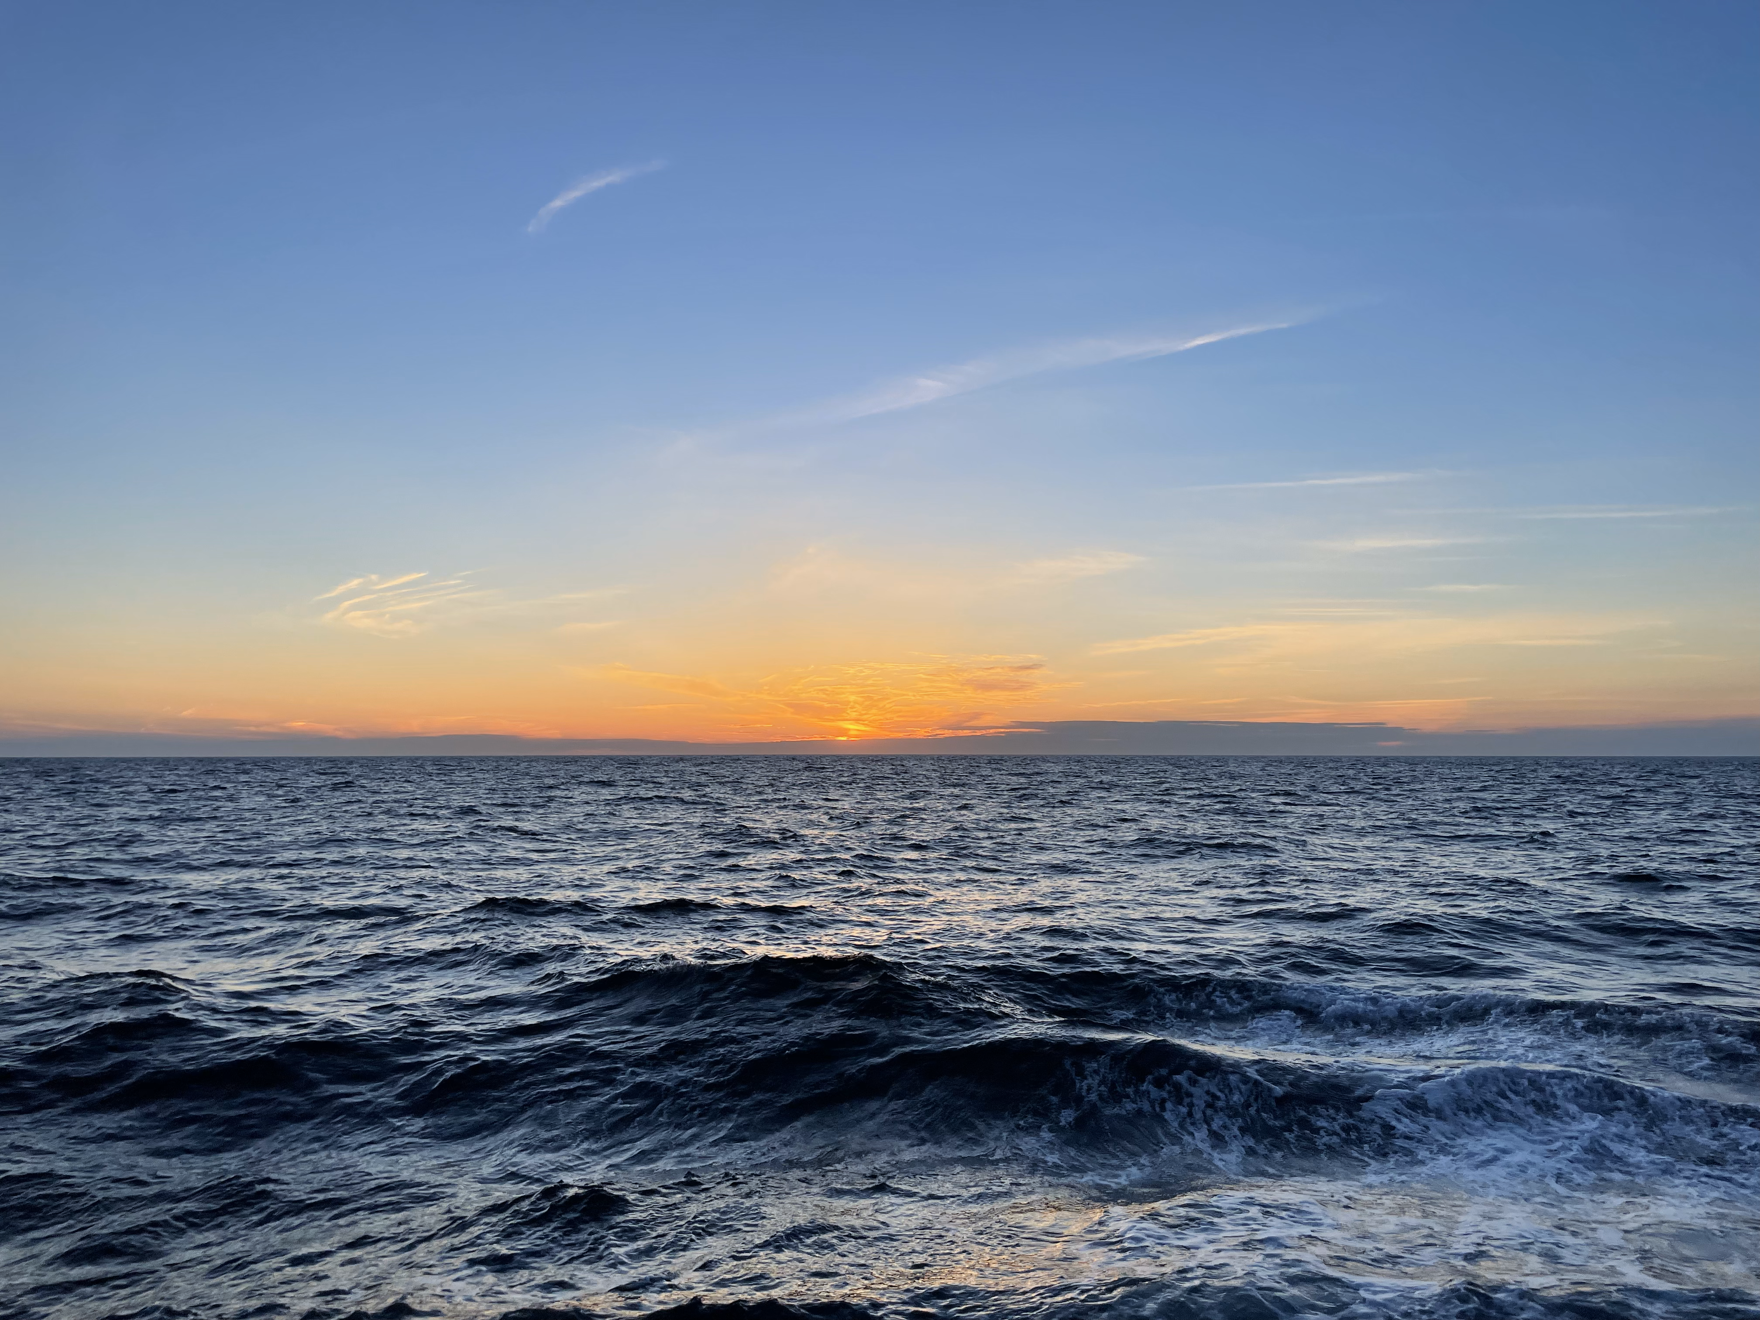





The Impact of Water Sound Speed on Deep Learning Seabed Classification from Shipping Noise
Alexandra M. Hopps-McDaniel
Tracianne B. Neilsen, William S. Hodgkiss, Jason D. Sagers, Preston S. Wilson
Acoustical Society of America | New Orleans, LA | May 2025
Notes:
Thank my co authors, especially those who helped collect the data during the SBCEX

Slide 2
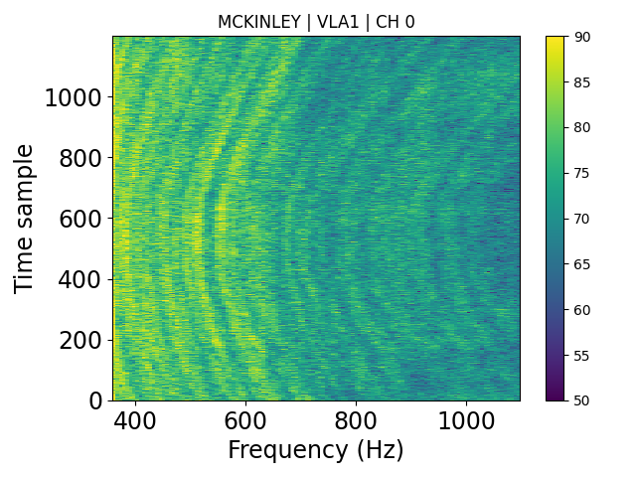
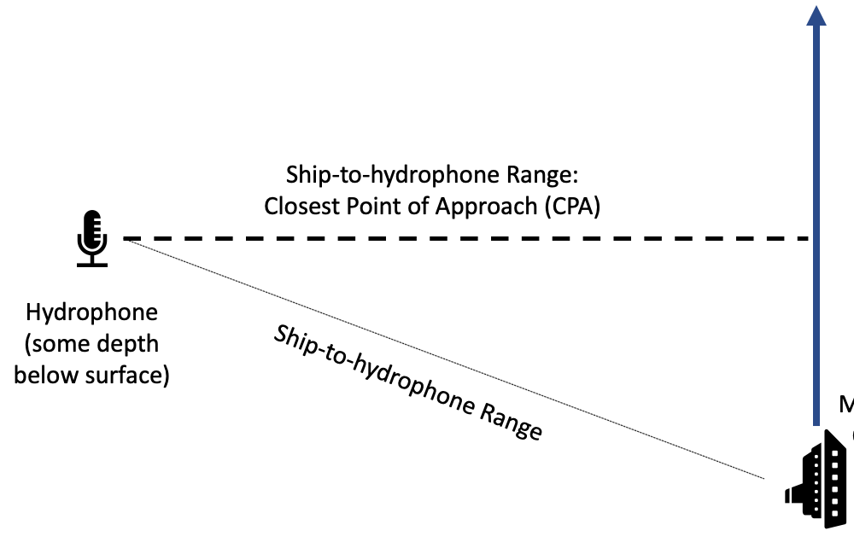
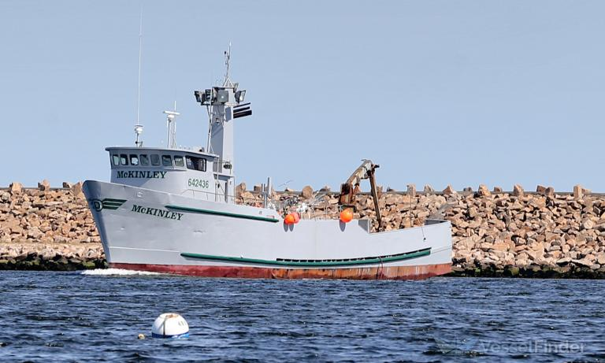
Measured signals encode seabed information
MCKINLEY
Measured SPEC
CPA
MCKINLEY, Fishing Vessel - Details and current position - IMO 8852588 - VesselFinder
Notes:
Different seabed have acoustically distinct effects on the sound propagation which results in sound signals that have the seabed properties encoded in them.
This signal will look largely different depending on the properties of the seabed it is traveling over.
My project focuses on extracting information from the seabed

Slide 3
Challenges of using deep learning for ocean acoustics
Lack of labeled training data
Variability in seabed composition
Variability in water depth
Variability in the ocean water sound speed profile (SSP)
How can you account for SSP variability in a deep learning model?

Slide 4
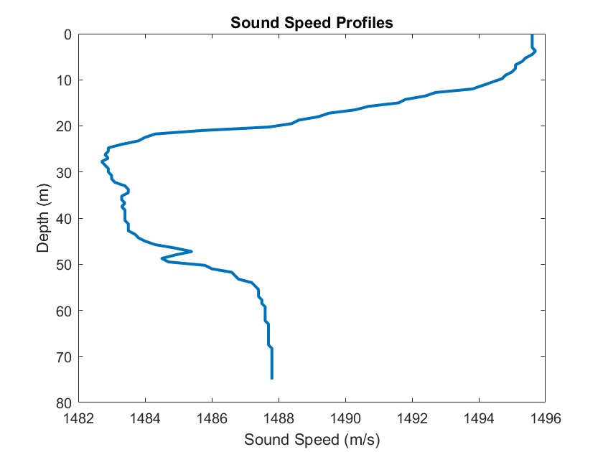
Research goals
Train networks based on known SSP close in location and time to test data
Given
Train networks based on known SSP
close in location but not in time to test data
Measured SOO noise
Train network with a general set of SSPs not close in location or time
Apply transfer learning to general SSP network using known SSP close in location and time
SSP close in location and time
Notes:
4 different cases

Slide 5

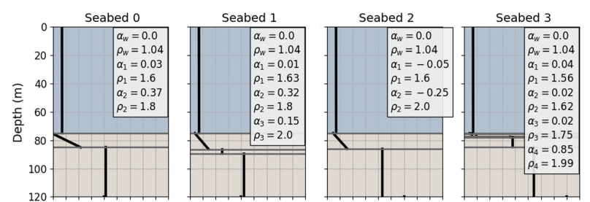
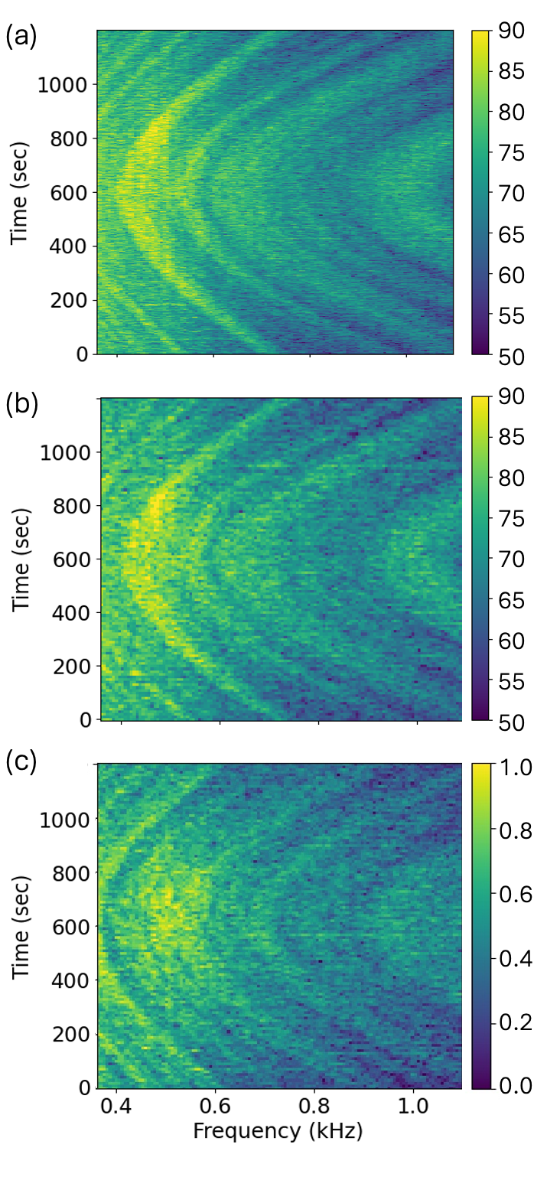
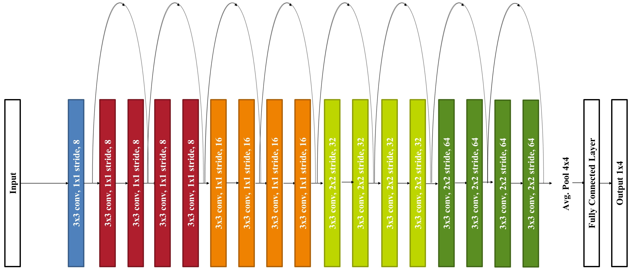
Deep Learning Methods
Measured Data
Synthetic Data
Train ML Network
Classification
1x34 output
Notes:
Overview and step through each part

Slide 6
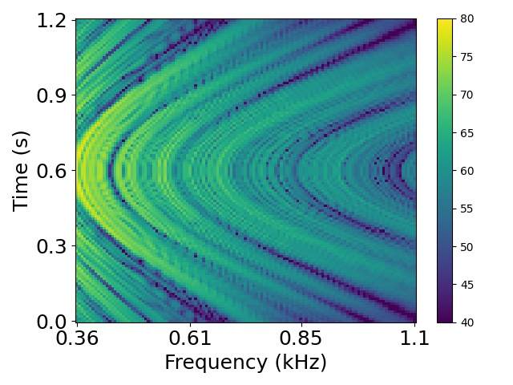
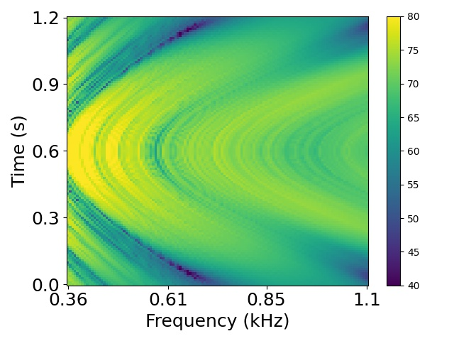
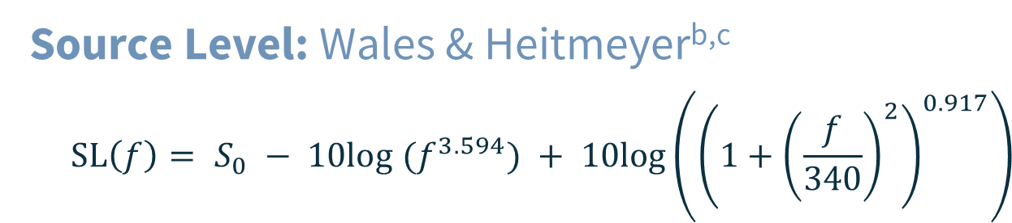
Synthetic source level of ships
Synthetic Data
$$RL\left(f,θ,z_{s},z_{r},r\right)=SL\left(f\right)−TL\left(f,θ,z_{s},z_{r},r\right)$$
Source Level: Wales & Heitmeyer^{b,c}
$$SL\left(f\right)= S_{0} − 10log (f^{3.594}) + 10log\left({\left(1+{\left(\frac{f}{340}\right)}^{2}\right)}^{0.917}\right)$$
Suitable for the 360 - 1100Hz band
b. Wales & Heitmeyer (2002). An ensemble source spectra model for merchant ship-radiated noise. JASA.
c. Heitmeyer et al. (2003). Shipping noise predictions: capabilities & limitations. MSTJ
Notes:
Lack of labeled measured data
Synthetic data must capture the full variation of measured samples

Slide 7
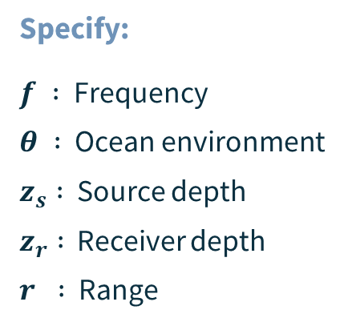
Synthetic transmission loss of ships
Step 1: Synthetic Data
$$RL\left(f,θ,z_{s},z_{r},r\right)=SL\left(f\right)−TL\left(f,θ,z_{s},z_{r},r\right)$$
Transmission Loss: ORCA
Normal-mode, range-independent modelª
^{Specify:}
$f :$ Frequency
$θ :$ Ocean environment
$z_{s} :$ Source depth
$z_{r} :$ Receiver depth
$r :$ Range
a. Westwood, et al. (1996). A normal mode model for acousto‐elastic ocean environments. JASA.
Notes:
Lack of labeled measured data
Synthetic data must capture the full variation of measured samples

Slide 8
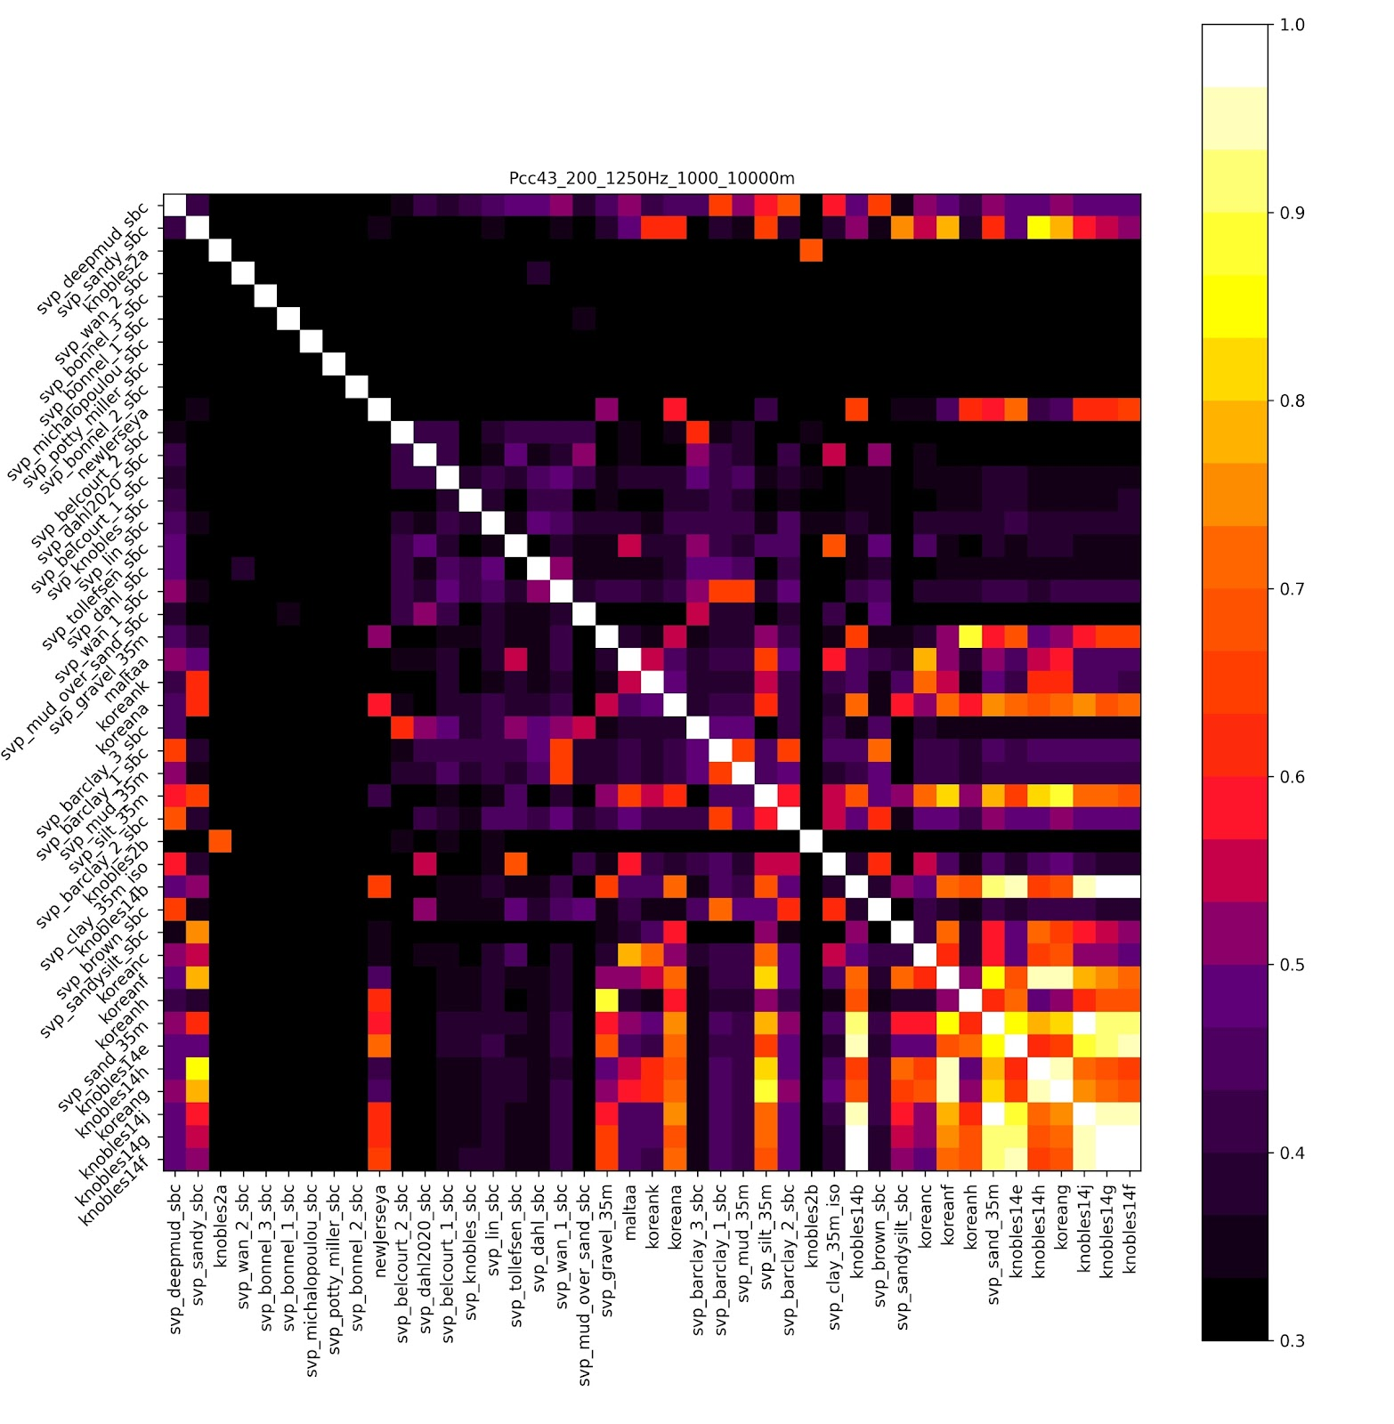
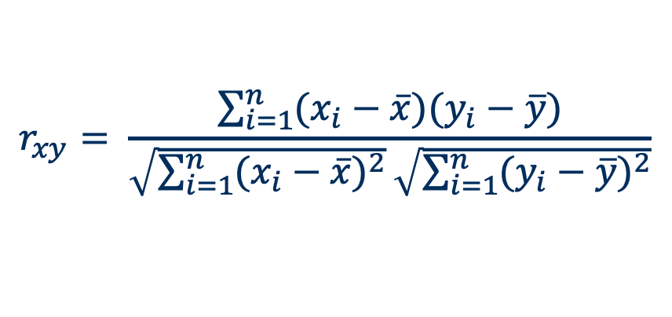
Pearson Correlation
Black: less similar seabed | Light: more similar
Synthetic Data
43 seabeds from peer-reviewed literature
Selected 34 seabeds with max correlation of less than 0.8
See Forman et al. JASA-EL (2021)
Notes:
Need to do synthetic plots for mckinley and carmen maybe?

Slide 9
34 Seabeds: ordered by cp₁^{top}
number | name | cp₁^{top}
0 | svp_lin_sbc.toml | 1387.4
1 | svp_knobles_sbc.toml | 1436.4
2 | svp_dahl_sbc.toml | 1445
3 | svp_belcourt_2_sbc.toml | 1445
4 | svp_potty_sbc.toml | 1452
5 | svp_wan_2_sbc.toml | 1452.2
6 | svp_belcourt_1_sbc.toml | 1453
7 | svp_deepmud_sbc.toml | 1453.8
8 | svp_barclay_2_sbc.toml | 1455
9 | svp_barclay_3_sbc.toml | 1459
10 | svp_bonnel_1_sbc.toml | 1464
11 | svp_wan_1_sbc.toml | 1466.7
12 | svp_mud_over_sand_sbc.toml | 1468.8
13 | svp_barclay_1_sbc.toml | 1470
14 | svp_mud_35m.toml | 1470
15 | svp_bonnel_2_sbc.toml | 1471
16 | svp_bonnel_3_sbc.toml | 1474
number | name | cp₁^{top}
17 | svp_dahl2020_sbc.toml | 1478.8
18 | svp_brown_sbc.toml | 1479
19 | svp_michalopoulou_sbc.toml | 1491
20 | svp_clay_35m.toml | 1500
21 | svp_tollefsen_sbc.toml | 1508
22 | maltaa.toml | 1510
23 | west_florida | 1540
24 | koreanc.toml | 1553
25 | koreana.toml | 1558
26 | koreank.toml | 1567
27 | svp_silt_35m.toml | 1575
28 | svp_sandy.toml | 1591.7
29 | svp_sandysilt.toml | 1591.7
30 | knobles14j.toml | 1650
31 | newJerseya.toml | 1704.2
32 | koreanh | 1757
33 | svp_gravel_35m.toml | 1800
_sbc = geoacoustic inversion from SBCEX2017
All from peer-reviewed literature
Cp₁^{top}<1

Slide 10
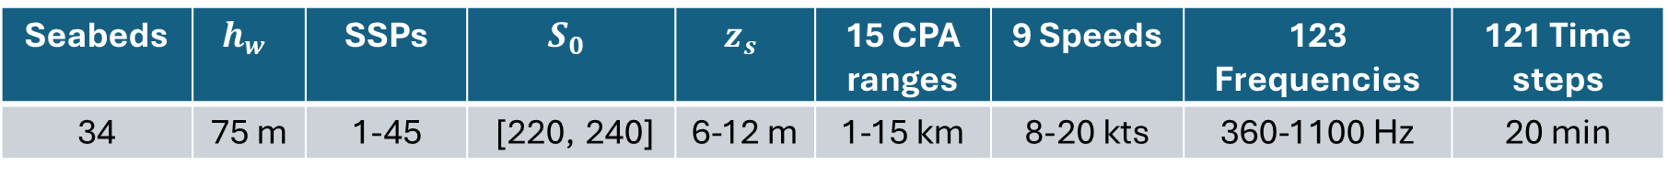
Training Data Set Parameters
Synthetic Data
Seabeds | $$h_{w}$$ | SSPs | $$S_{0}$$ | $$z_{s}$$ | 15 CPA ranges | 9 Speeds | 123 Frequencies | 121 Time steps
34 | 75 m | 1-45 | [220, 240] | 6-12 m | 1-15 km | 8-20 kts | 360-1100 Hz | 20 min
13,770 synthetic spectrograms for each SSP
Networks trained with anywhere from 1-45 SSPs
Notes:
Overview and step through each part

Slide 11
Deep Learning Methods
Measured Data
Synthetic Data
Train ML Network
Classification
1x34 output
Notes:
Overview and step through each part

Slide 12
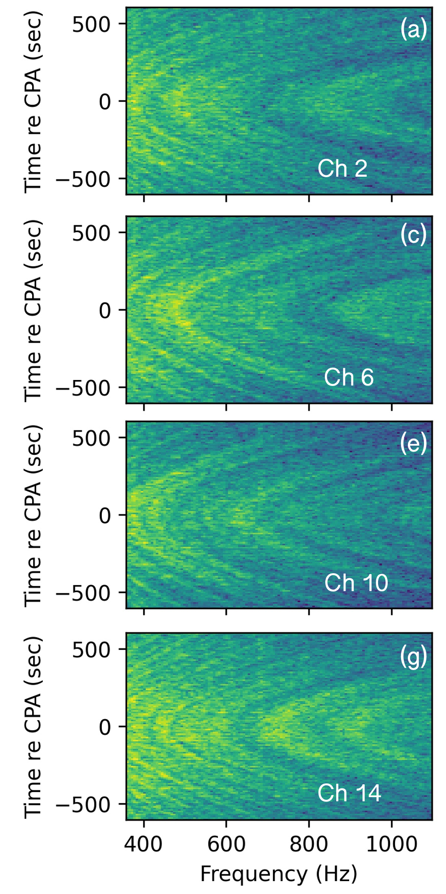
Resnet-18
Training
1x34 classification output
Notes:
There are 1000 neurons in the fully connected layer.
Why this network? There was a paper published by Escobar et al. that studied several different architectures and found this to be the best for this research question.

Slide 13
Ensemble Method
Synthetic Training Data
Trained Networks
Training
Input data from channels
1, 5, 9, 13
ResNet-18 Base Learner 1
Ensemble learning
Combines information through the water column in a memory efficient way
Address overfitting, underfitting, and noise
Include depth-dependent information
Reduced burden of extra memory during training
Input data from channels
2, 6, 19, 14
ResNet-18 Base Learner 2
Input data from channels
1, 2, 3, 4
ResNet-18 Base Learner 3
.
.
.
.
.
.
Input data from channels
13, 14, 15, 16
ResNet-18 Base Learner N
13
Lau, Ginger E., et al. "Ensemble approach to deep learning seabed classification using multichannel ship noise." The Journal of the Acoustical Society of America 157.3 (2025): 2127-2149.
Notes:
Prior to this only one channel was used. Ginger’s paper looks at using different channel combinations. We found that 4 and 8 give about the same result – 4 uses less memory.

Slide 14
Hard Voting vs Soft Voting
Training
Network Output
Hard Voting
Soft Voting
Input data from channels
1, 5, 9, 13
ResNet-18 Base Learner 1
Classifier output 1
Max1
Input data from channels
2, 6, 19, 14
ResNet-18 Base Learner 2
Classifier output 2
Max2
Average Classifier output
.
.
.
.
.
.
.
.
.
Majority Voting
Input data from channels
13, 14, 15, 16
ResNet-18 Base Learner N
Classifier output 2
Max3
14
Notes:
Overview and step through each part

Slide 15
Deep Learning Methods
Measured Data
Synthetic Data
Train ML Network
Classification
1x34 output
Notes:
Overview and step through each part

Slide 16
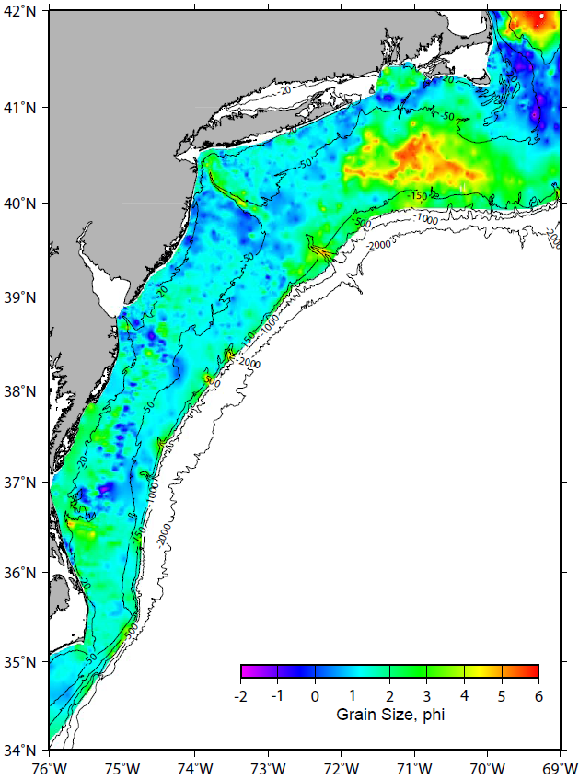
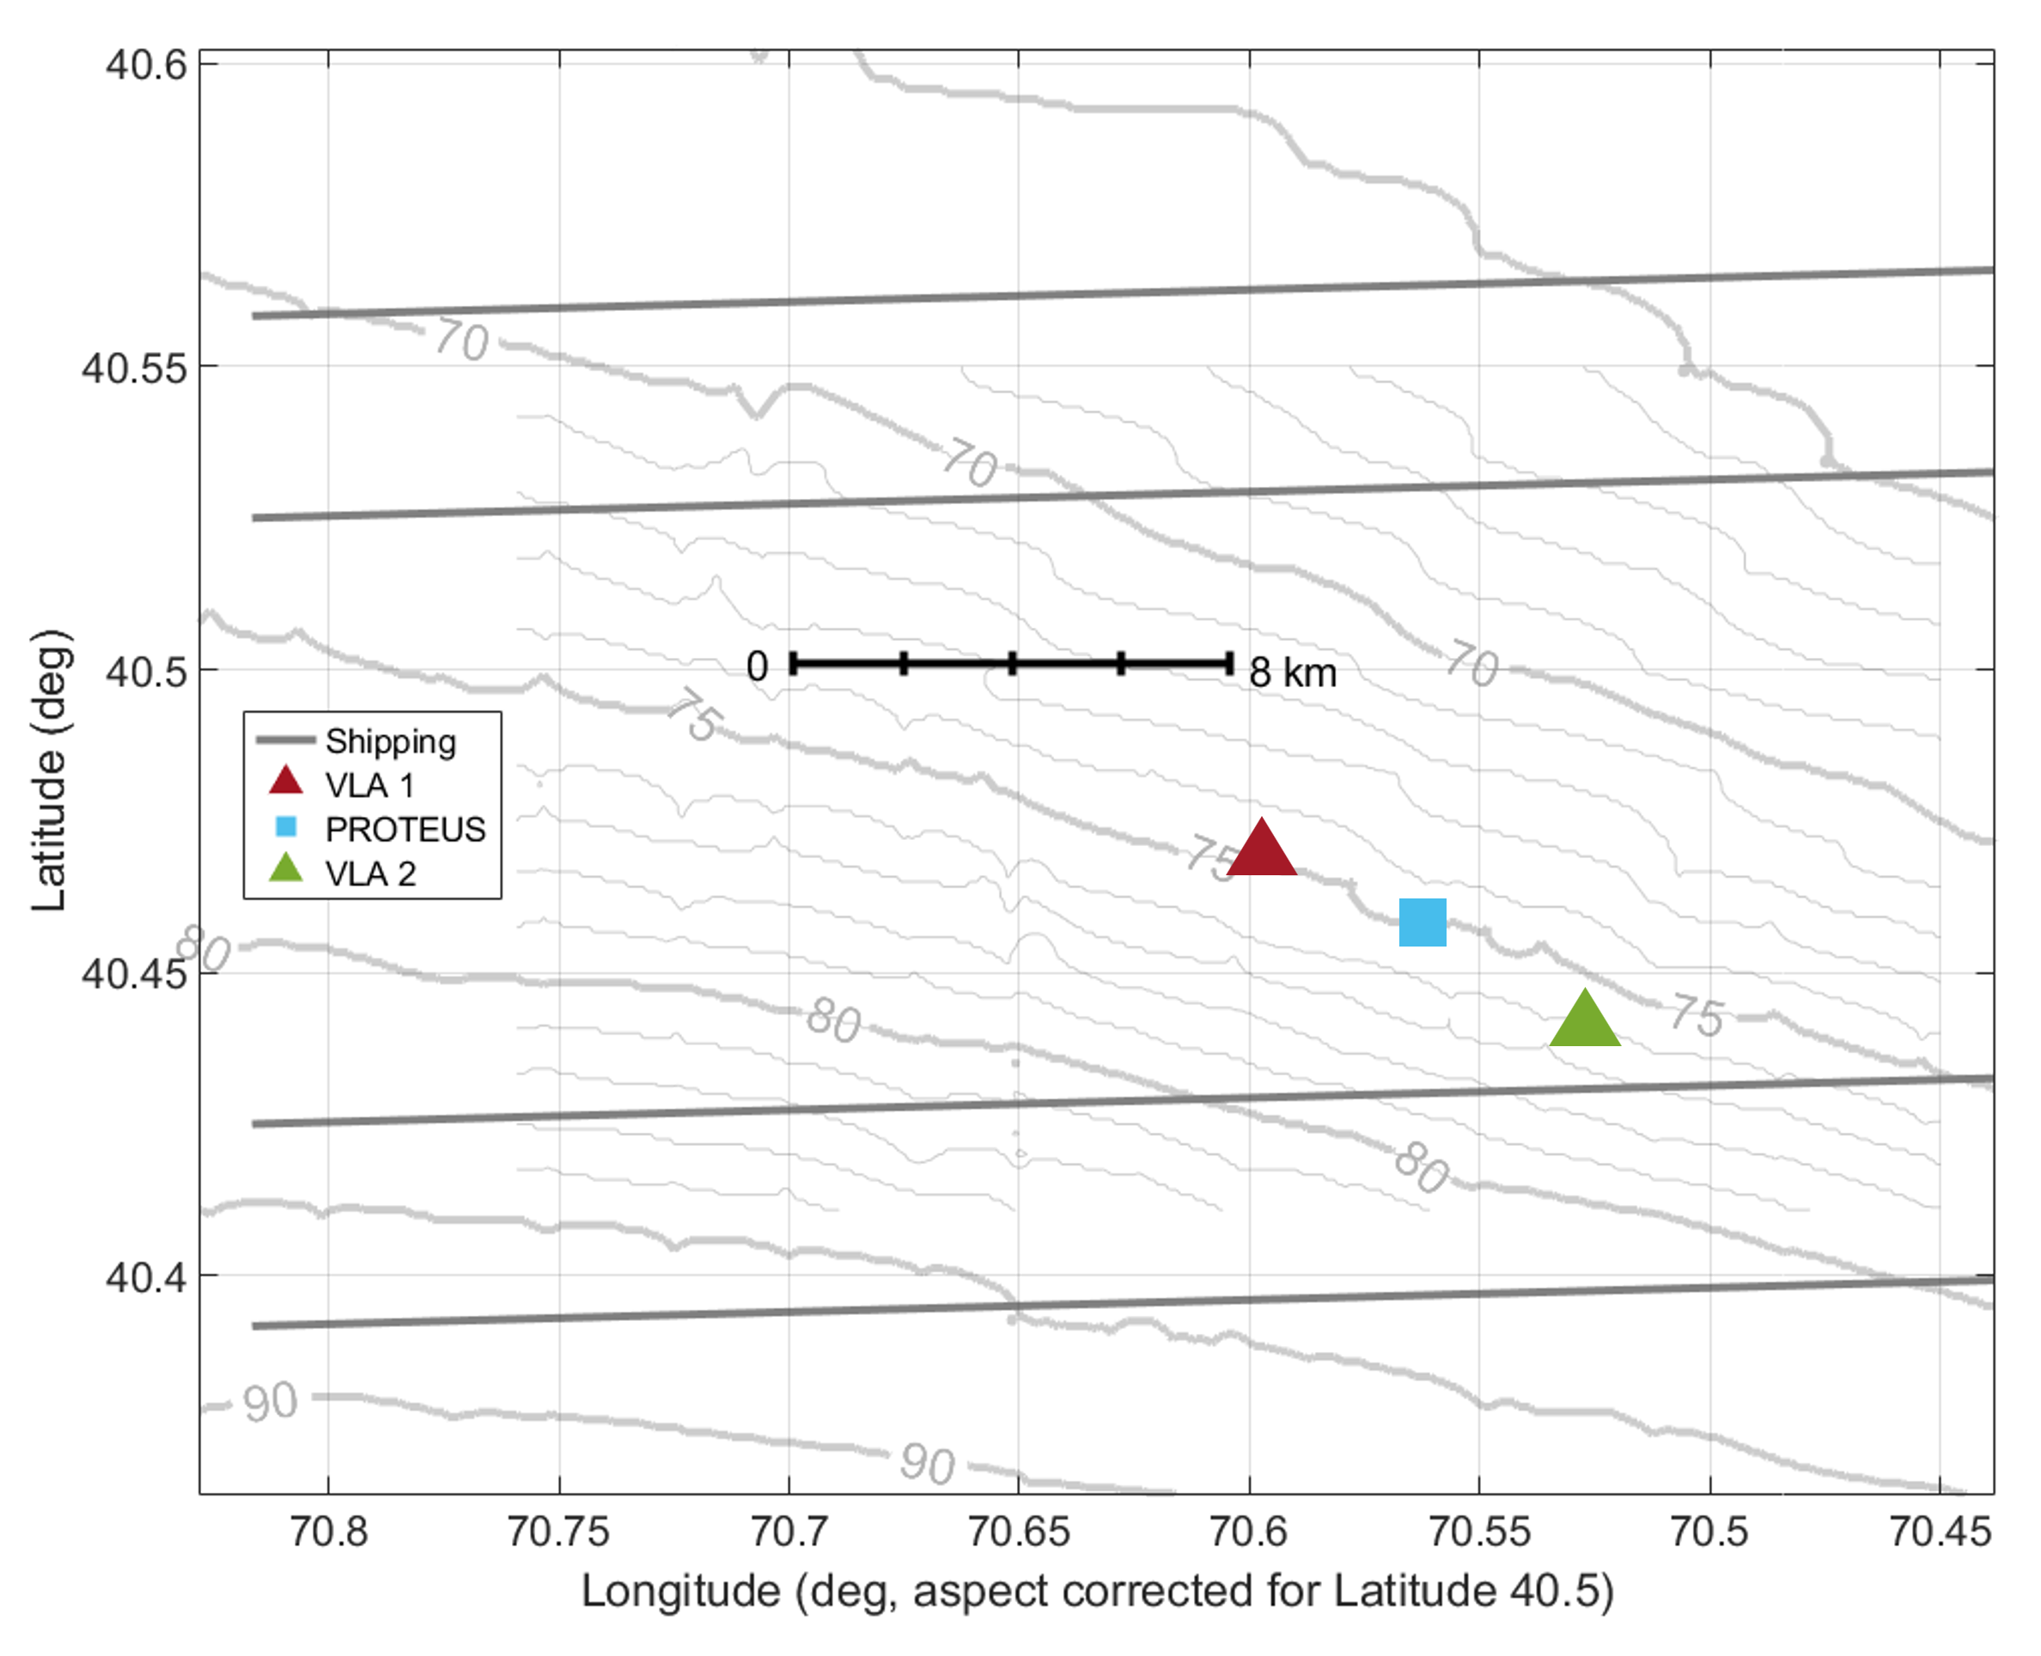
Seabed Characterization Experiment
Measured Data
New England Continental Shelf
Water depth: ~ 75 m
Data collection:
2017
2022
Two 16-CH VLAs
Latitude – deg.
Longitude – deg.
Notes:
Scripps Institution of Oceanography

Slide 17
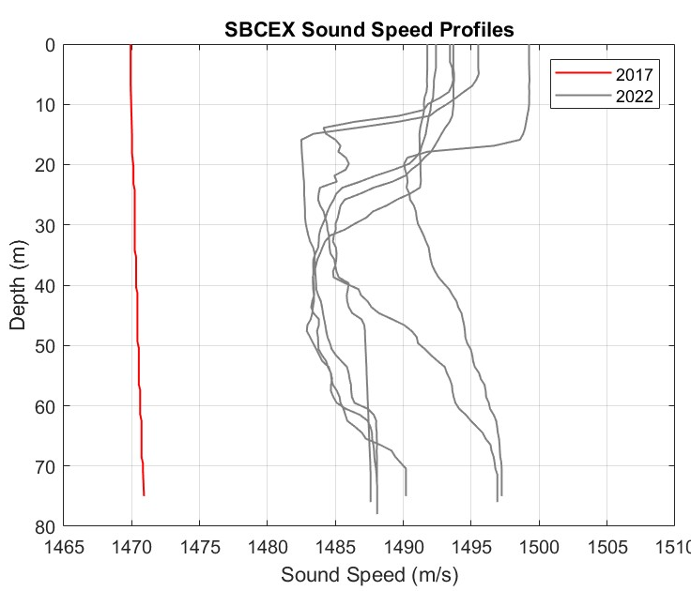
SSP Variability Between Years
Measured Data
Networks
2017 SSPs
2022 SSPs
2017 & 2022 SSPs
Notes:
Slightly upward refracting for 2017 SSP – the water was quite well mixed

Slide 18
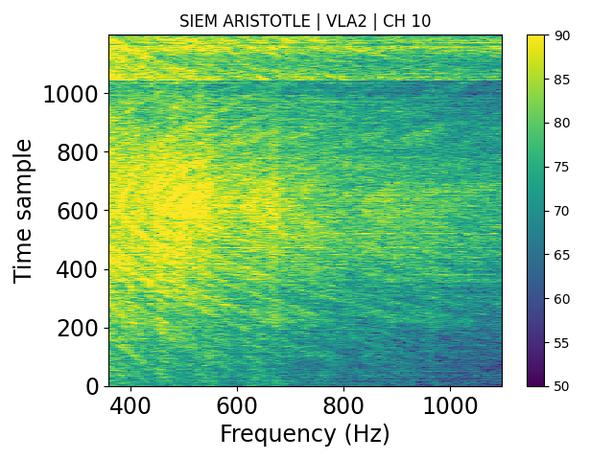
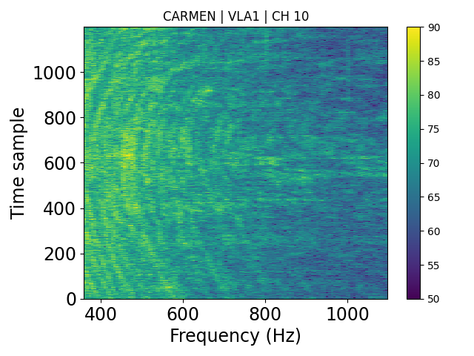
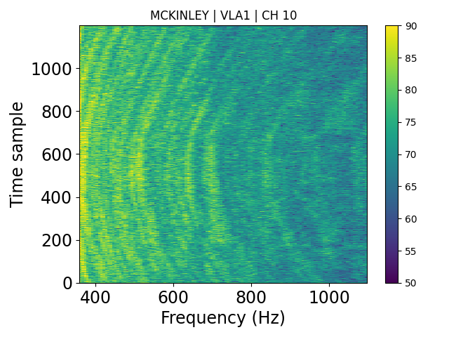
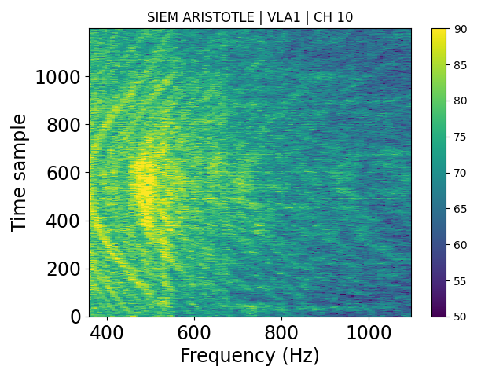
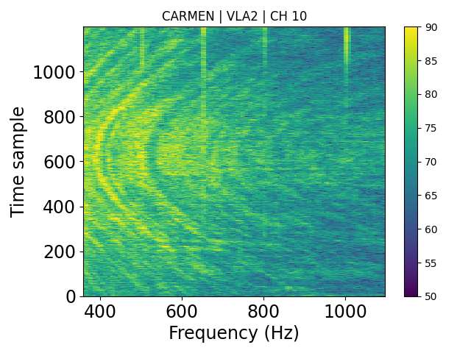
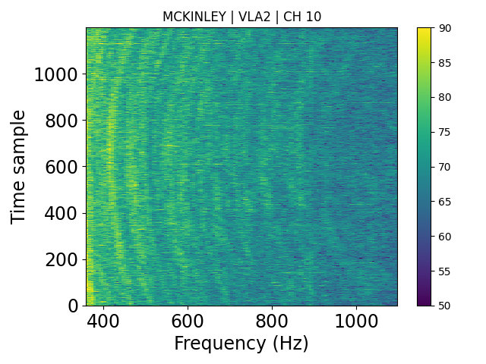
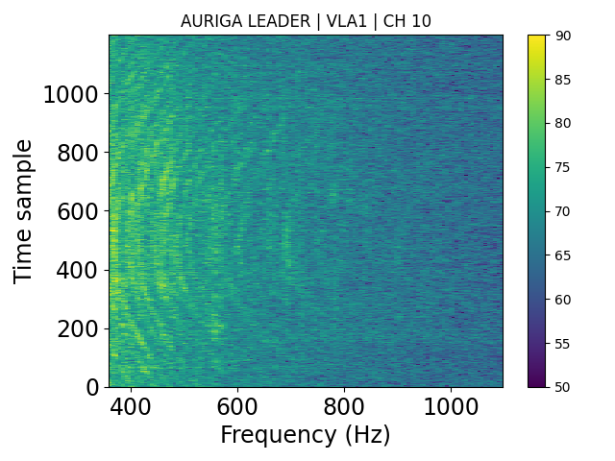
Deep Learning Methods
2022 Ships

Slide 19
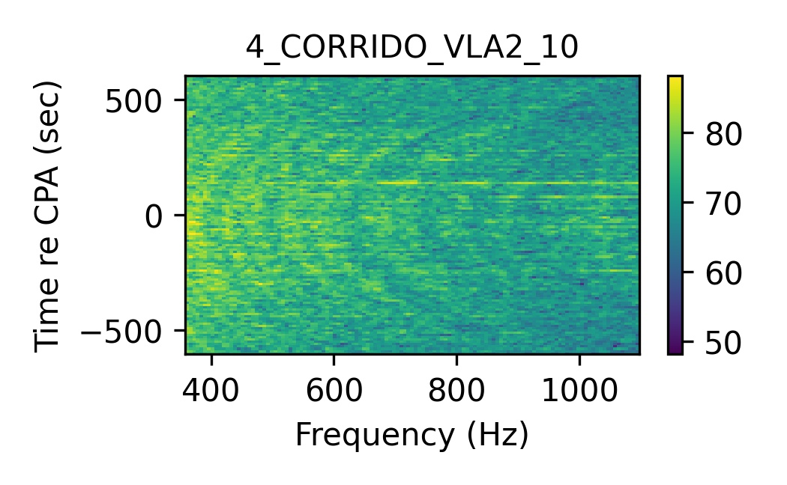
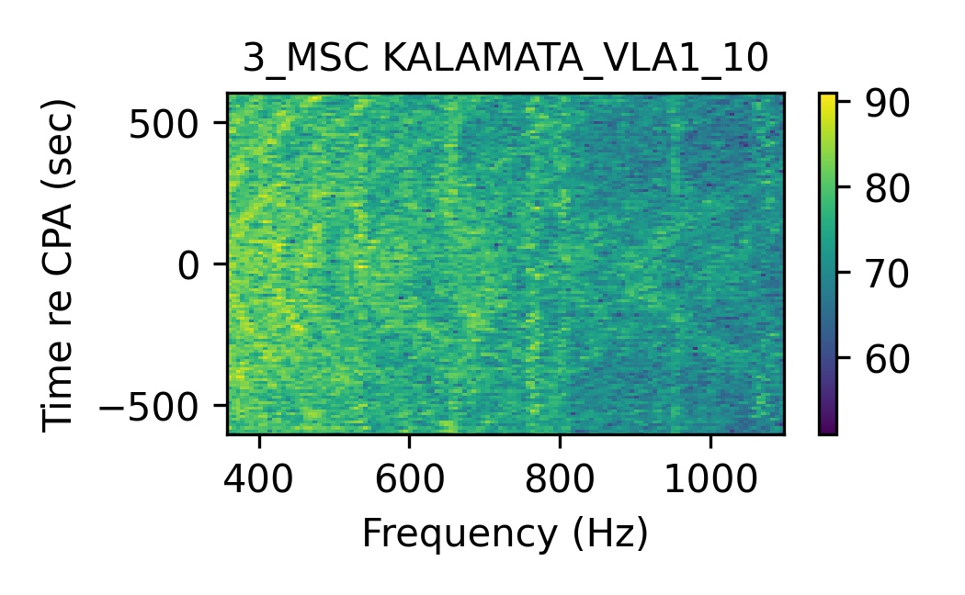
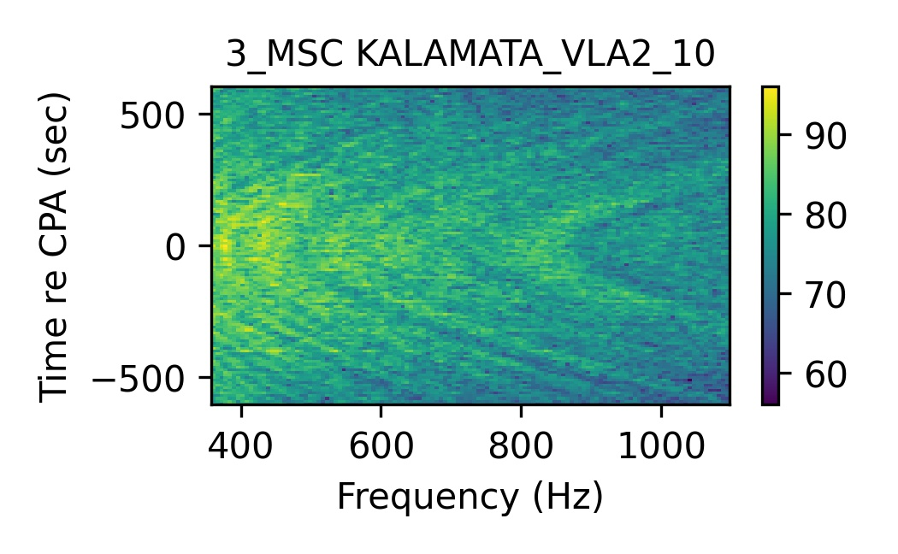
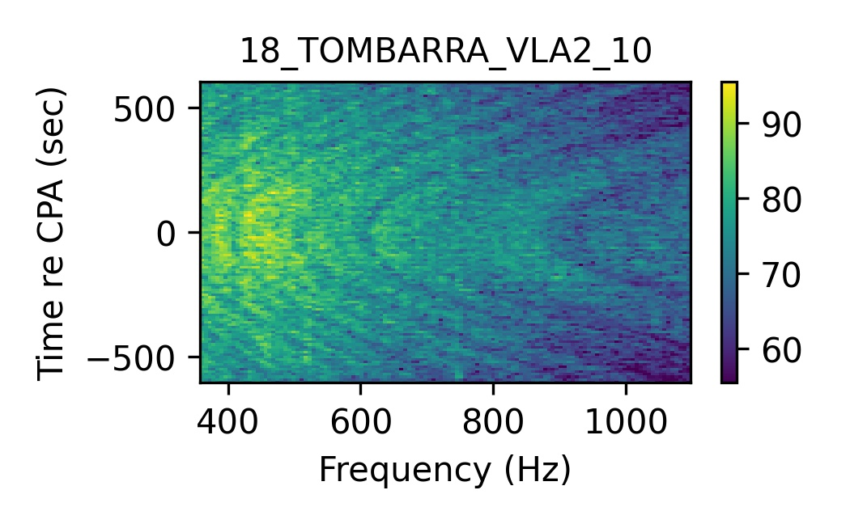
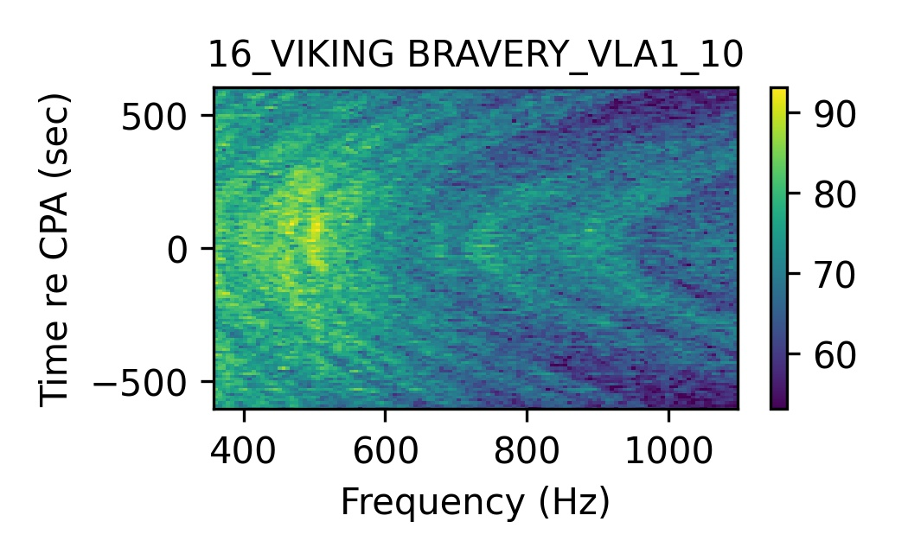
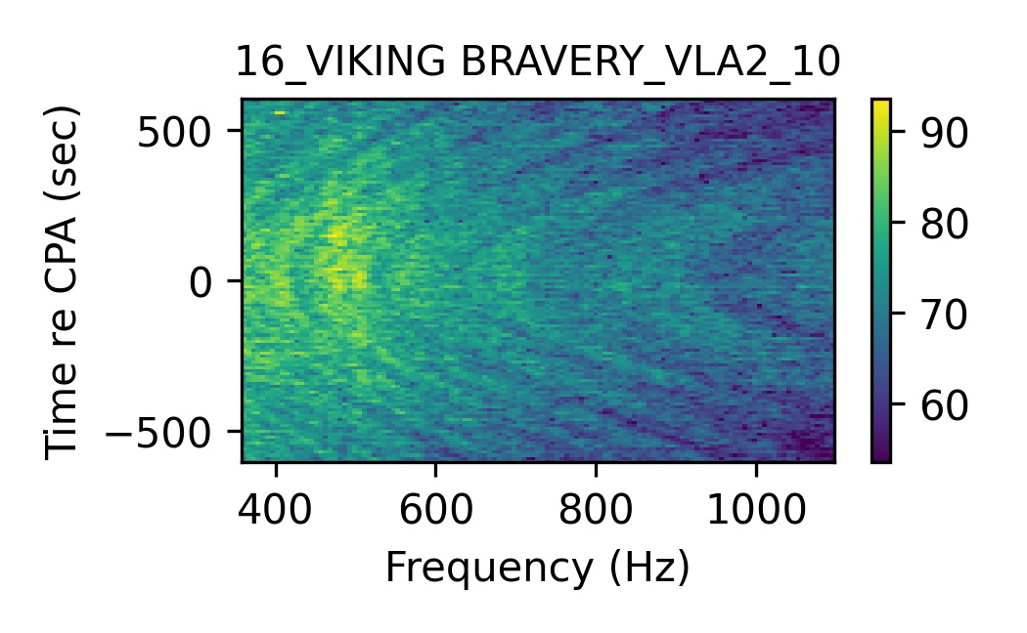
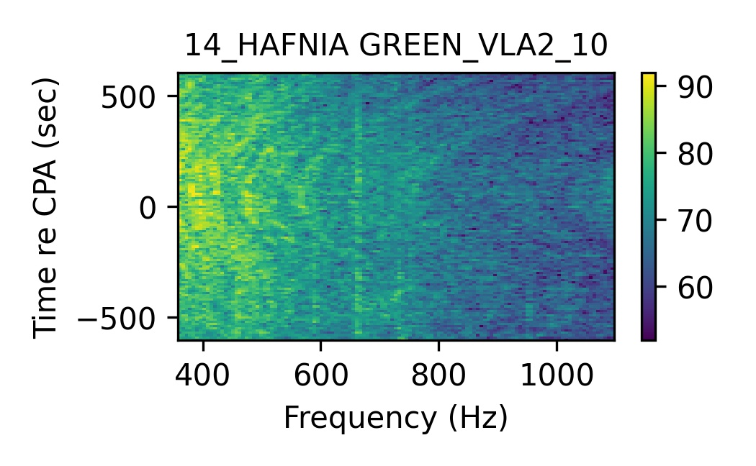
Deep Learning Methods
2017 Ships

Slide 20
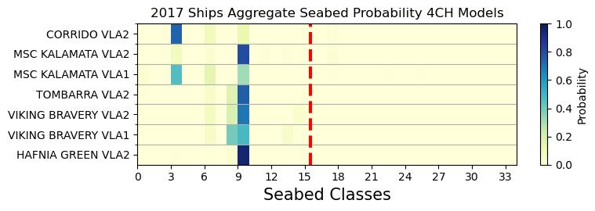
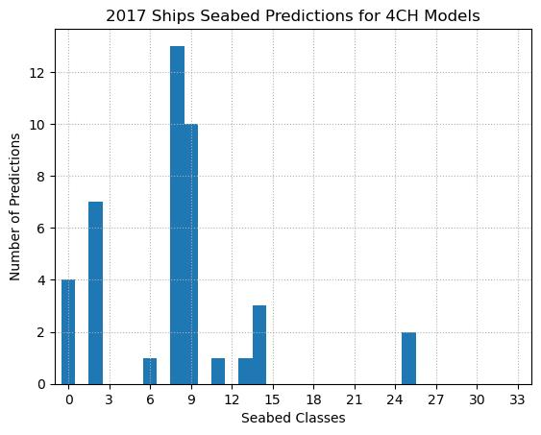
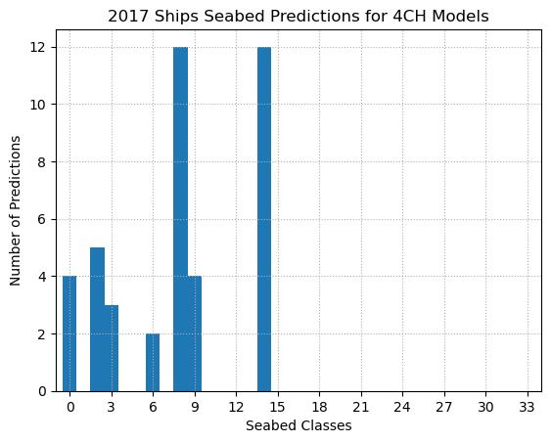
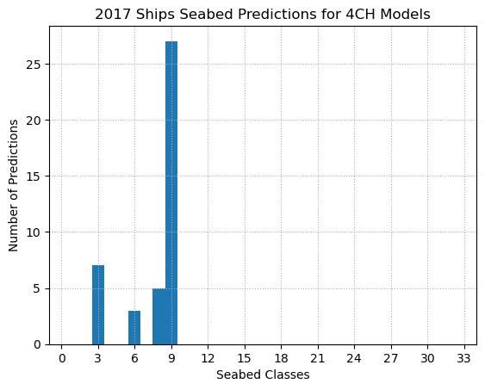
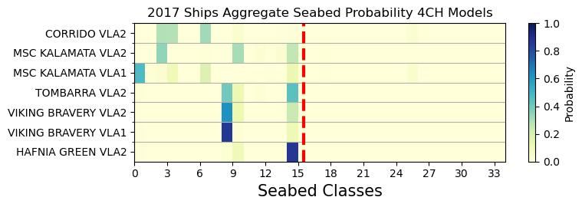
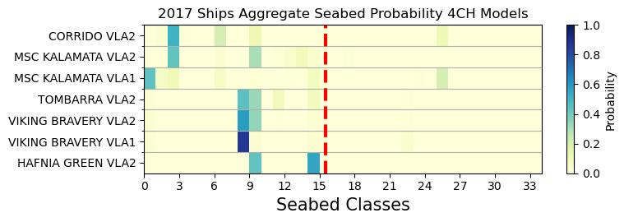
Results 2017 ships
Soft Voting
Hard Voting
Training data from SBCEX 2017 SSPs
Training data from SBCEX 2017 & 2022
Training data from SBCEX 2022 SSPs
Notes:
We are not trying to trying to find a local answer of the seabed composition – an effective model over the entire sound propagation path.

Slide 21
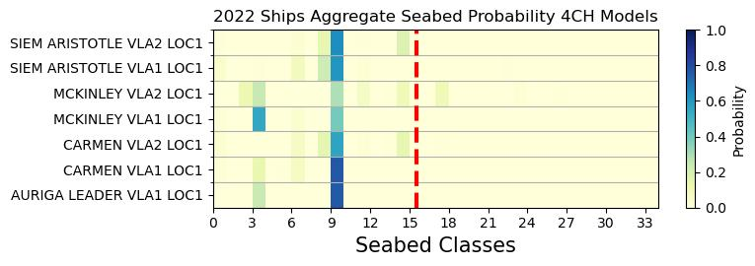
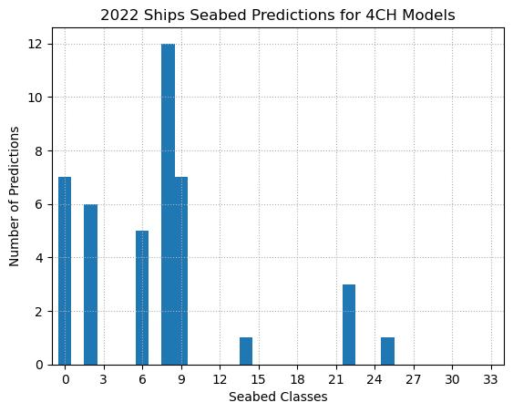
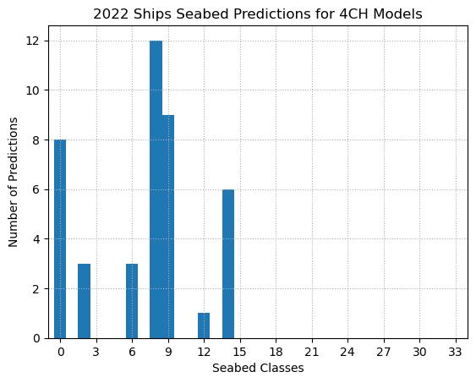
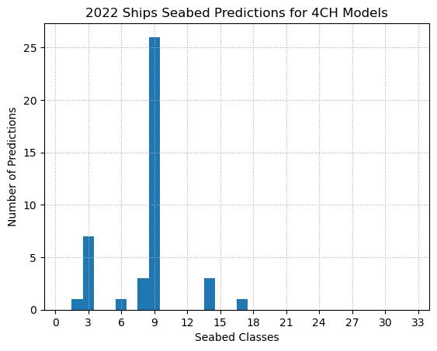
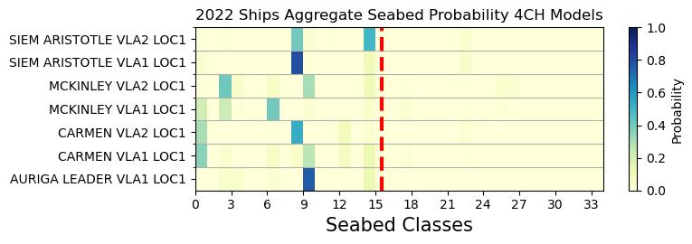
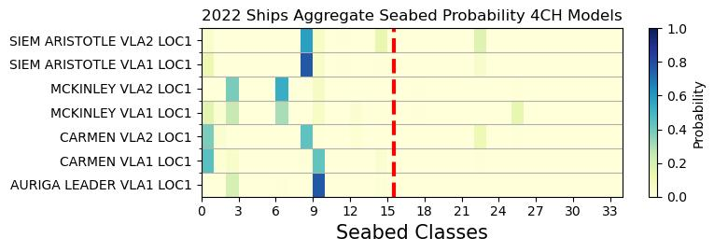
Results 2022 ships
Soft Voting
Hard Voting
Training data from SBCEX 2017 SSPs
Training data from SBCEX 2017 & 2022
Training data from SBCEX 2022 SSPs
Notes:
We are not trying to trying to find a local answer of the seabed composition – an effective model over the entire sound propagation path.

Slide 22
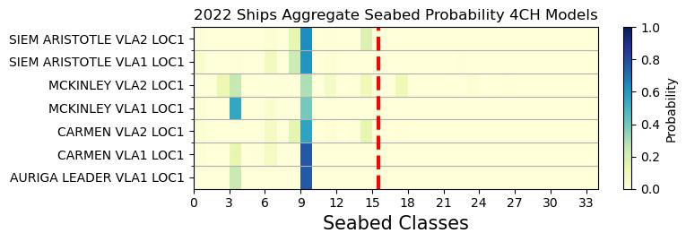


Seabed Predictions for SBCEX Ships
Training data from SBCEX2017 SSPs
Training data from SBCEX2017&2022
Ships from SBCEX 2017
Ships from SBCEX 2022
Training data from SBCEX2022 SSPs
Notes:
We are not trying to trying to find a local answer of the seabed composition – an effective model over the entire sound propagation path.

Slide 23
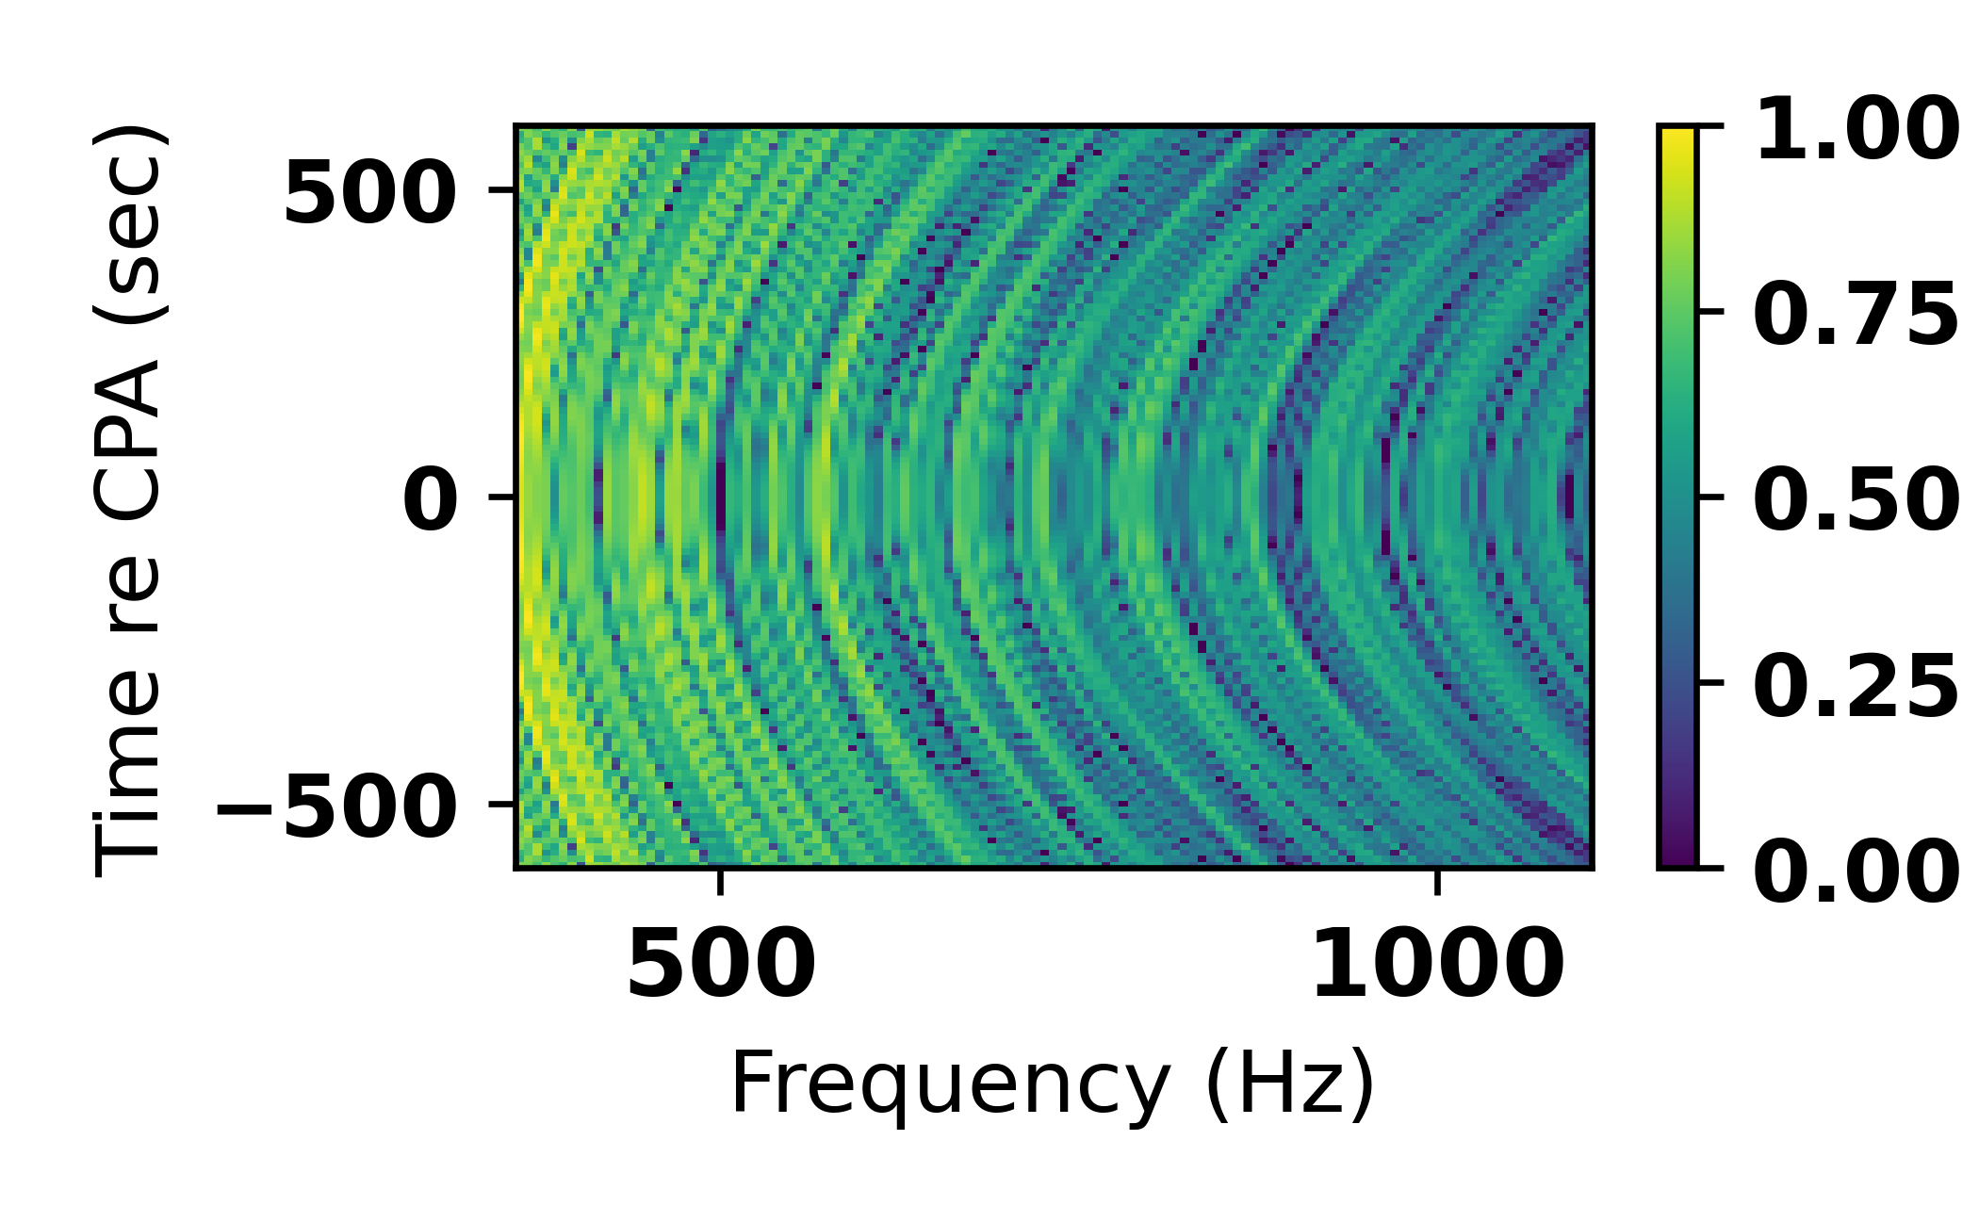
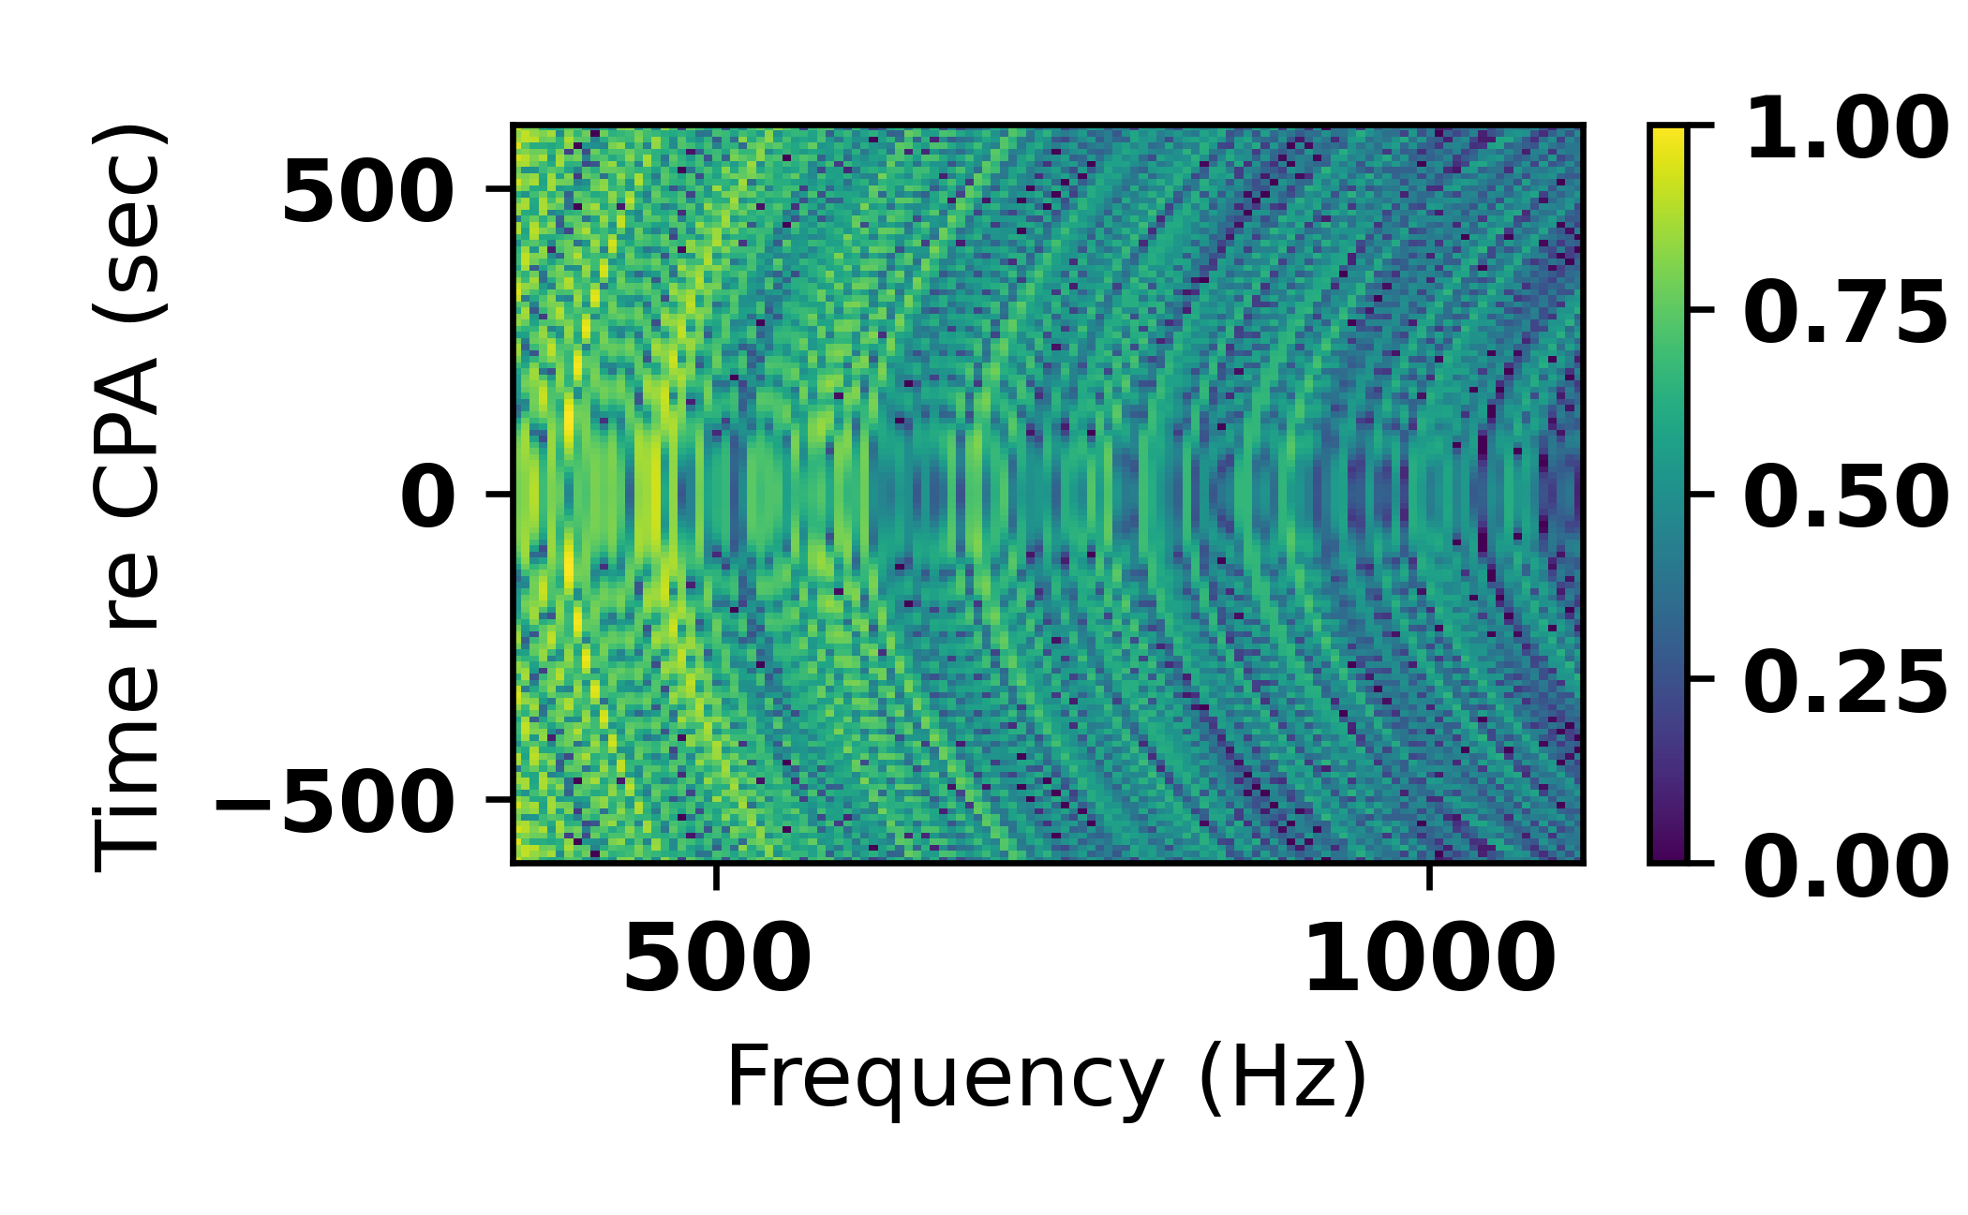
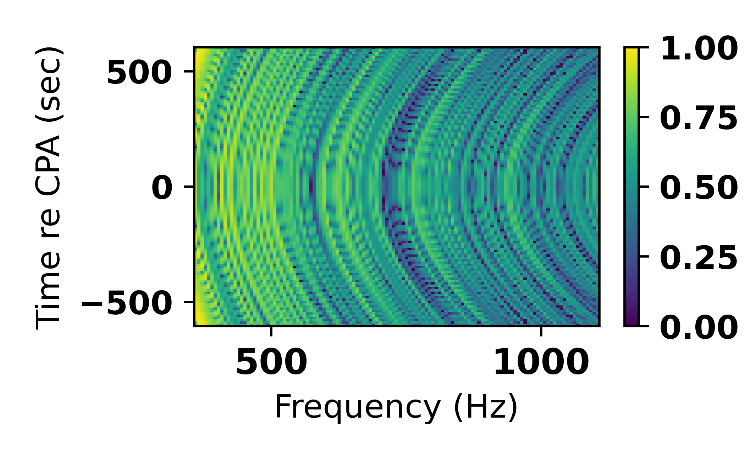
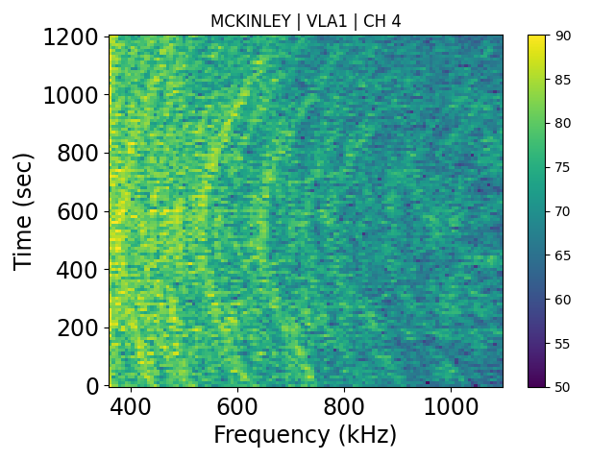



Plots of Synthetic Data with MCKINLEY Parameters
Sb 0
Sb 6
Sb 9
Sb 2
Sb 8
Sb 14
Notes:
What about seabed 33? Didn’t talk about the scaling at all.

Slide 24



Global SSPs
World Ocean Atlas NOAA
Synthetic training data:
68,850 spectrograms
Ships from SBCEX 2017
Ships from SBCEX 2022
2017
2022
https://www.ncei.noaa.gov/access/world-ocean-atlas-2023/bin/woa23.pl
Notes:
How long is the fully connected layer: look up standard resnet 18; need to double check amount of synthetic data
Viking bravery and hafnia green had extremely low background noise

Slide 25
Transfer Learning
SSPs for Global Training Data
Only the last layer of the Resnet-18 is updated during back propagation
Synthetic training data from SBCEX 2022 SSPs
Smaller data sets and faster training
3 SSP 1/9th source properties
1 SSP all source properties
SSPs for Transfer Learning Data
Notes:
How long is the fully connected layer: look up standard resnet 18

Slide 26



Transfer learning One 4-CH Case
Global Training data
15 global SSPs
135 random sets of ship parameters
= 68,850 synthetic data samples
Transfer Learning Training Data
Mean of measured SBCEX 2022 SSPs
15 random sets of ship parameters
= 510 synthetic data samples
Original Training data
6 measured SBCEX 2022 SSPs
135 random sets of ship parameters
= 27,000 synthetic data samples
Notes:
This is just 2022 ships – mention that

Slide 27



Ensemble Transfer Learning
Global 15 ssp
TL 3SSP 1/9th data
TL 1SSP All data
Notes:
We need to take into account the correlation between the seabeds. Applying the ensemble method to the TL

Slide 28
Conclusions
TL using simulated training data and a known SSP shows promise in adapting a trained network to a new environment
Significance: real time application of machine learning to an area of interest
Transfer learning is faster than training because already have a model prepped for a new data set

Slide 29


Future work
Transfer learning with a 45 SSP case
Determining how much synthetic data is required for the transfer data set
Assess performance on ships with tones or greater signal to noise ratio

Slide 30
Thank you!

Slide 31
Conclusions
TL using simulated training data and a known SSP shows promise in adapting a trained network to a new environment
Significance: real time application of machine learning to an area of interest
Transfer learning is faster than training because already have a model prepped for a new data set

Slide 32
Machine Learning Hyper-parameters
Max number of epochs: 100
Early stop criteria: Validation loss does not improve by 0.001 for 3 epochs
Batch size: 1024 (decreased to 64 for transfer learning)
Learning Rate: Starts 0.001 & changes each epoch using cosine annealing scheduler
Training/Validation Split: K-fold cross validation (k=5)
Optimizer: AdamW

Slide 33

What SSPs used for Transfer Learning
1 SSP: mean
3 SSP: min, max and mean
6 SSP: bolded (closest in location and time to measured ships)

Slide 34
Training Accuracy
At least 70% accuracy for all models.
96% accuracy average for models trained with SBCEX 2017, 2022, or combined synthetic data sets
94% accuracy average for models trained with the global synthetic data sets
90% accuracy average for models with transfer learning data from SBCEX 2022 synthetic data set

Slide 35
Why are some of the 2017 ships better?
Very low background noise
Feature work: add more randomly drawn noise during training to make models more robust

Slide 36
Correlation between seabeds
Some of the seabed are more correlated with each other than others
To do: When averaging the classifier output, account for the correlation by computing a weighted average
Network might have a hard time distinguishing between seabeds that are highly correlated

Slide 37
Tones in some of the specs
ORCA had trouble calculating modes at certain frequencies
These broadband noises are often features in measured spectrograms any time there are tonal sounds in the area

Slide 38
Mapping of synthetic data
Synthetic Data
Select sparse representation:
121 time steps over 20 mins
123 frequencies 360-1100 Hz
Zero-mean levels
Divide by the standard deviation: σ=1
Reassign outliers to +/- 3σ
Map (-3σ, 3σ) => (0,1)
Add white gaussian noise to each sample during training
Amos et al. Proc. Mtgs. Acoust. 47, 070016 (2022).
Notes:
Mapping allows for focusing on striation pattern and not on the ship level

Slide 39





Environment Models
Notes:
Mapping allows for focusing on striation pattern and not on the ship level

